Slide 1
Static Analysis Tools and SonarQube
Alba Martinez Anton, Simreet Behera and Conor Byrne
Notes:
Part 1- Conor: Static Analysis Tools
Part 2- Simreet: SonarQube (history and functionalities)
Part 3- Alba: Example of SonarQube

Slide 2
Overview:
About Static Analysis and its tools
SonarQube and its functionalities
Example of how use SonarQube
Limits of Static Analysis tools

Slide 3
Static Analysis
The inspection of source code with the intent of finding bugs and vulnerabilities.
Carried out at the implementation stage of the Security Development Lifecycle.
Some static analysis techniques are derived from compiler techniques such as lexical analysis.
Static Analysis tools can also be used in formal verification - but is it formal verification? Kind of...
https://www.owasp.org/index.php/Static_Code_Analysis
http://www.cs.colorado.edu/~kena/classes/5828/s12/presentation-materials/blackshearsam.pdf

Slide 4
Static Analysis Techniques
Data Flow Analysis: a process for collecting run-time information about data in programs without actually executing them.
Basic Block - logical group of sequential instructions
Control Flow Analysis - Control Flow Graph (CFG)
Control Flow Path - complete path in a CFG
Taint Analysis: identify variables that have been 'tainted' with user controllable input and traces them to possible vulnerable functions also known as a 'sink'.
https://www.ics.uci.edu/~lopes/teaching/inf212W12/readings/Woegerer-progr-analysis.pdf
https://www.owasp.org/index.php/Static_Code_Analysis
Notes:
Basic block: this implies that if any instruction in a basic block B is executed then all instructions in B are executed.
Taint: if a variable is tainted and passes to a sink without being sanitised, it is flagged as a vulnerability

Slide 5
Static Analysis Tools
Wide variation in how much work each individual tool does.
Cpplint - checks code against Google’s C++ style guide
CodePeer - identifies constructs that are likely to lead to runtime errors in Ada programs
Compuware Topaz for Program Analysis - generates data flow analysis graphs, highlights dependencies and much more
PVS-Studio - detects bugs and security weaknesses in the source code of programs, written in C, C++, C# and Java
https://www.viva64.com/en/pvs-studio/
https://www.compuware.com/topaz-modern-mainframe-development-testing/

Slide 6
PVS-Studio Example 1
From the X-Ray Engine used in the S.T.A.L.K.E.R game series.
BOOL CActor::net_Spawn(CSE_Abstract* DC){
....
m_States.empty();
....
}
PVS-Studio warning: V530 The return value of function ‘empty’ is required to be utilized.
https://medium.com/@CPP_Coder/static-analysis-in-video-game-development-top-10-software-bugs-a32b1ed4c5c1

Slide 7
PVS-Studio Example 2
From Unreal Engine 4
void UParticleModuleLocationSkelVertSurface::Spawn(....)
{ ....
int32 BoneIndex1, BoneIndex2, BoneIndex3;
if(!VertInfluencedByActiveBone(
Owner, SourceComponent, VertIndex[0], &BoneIndex1) &&
!VertInfluencedByActiveBone(
Owner, SourceComponent, VertIndex[1], &BoneIndex2) &&
!VertInfluencedByActiveBone(
Owner, SourceComponent, VertIndex[2]) &BoneIndex3)
{
....
}
PVS-Studio warning: V564 The ‘&’ operator is applied to bool type value. You’ve probably forgotten to include parentheses or intended to use the ‘&&’ operator.

Slide 8

SonarQube
An open-source platform developed by Sonar Source in 2007
Inspects the quality of code
Automatic reviews are performed
Detects bug, code smells and vulnerabilities
Reports are offered on various aspects, like duplicated code, unit tests, coding standards, etc.
Works on 20+ programming languages
Can be integrated with environments like Eclipse, Visual Studio, IntelliJ Idea
https://en.wikipedia.org/wiki/SonarQube

Slide 9
Why is such a tool needed?
During software development, issues were caused by low quality code. This caused:
Bad reputation of the company
Crashes in production
Therefore, SonarQube was aimed to provide solutions for the improvement of the following:
Maintainability
Reliability
Security
https://www.sonarsource.com/why-us/code-quality/

Slide 10
Maintainability
Normally referred to as technical debt
Issues associated with maintainability are referred to as “code smells”
Mostly no critical issues, but it is a collection of minor issues.
https://www.sonarsource.com/why-us/code-quality/

Slide 11
Reliability
These issues usually include potential bugs or pieces of code that show unexpected behaviour during run time
These are usually critical programming errors, so causes disturbances in business
Detection methods: deep analysis of code- state of variables at a given point of time can be understood
https://www.sonarsource.com/why-us/code-quality/

Slide 12
Security
Security issues include flaws/ vulnerabilities in the program
These issues can lead to the application behaving in a way which is not expected
Examples of these issues include SQL Injection and cross-site scripting
https://www.sonarsource.com/why-us/code-quality/

Slide 13
Features of SonarQube
Continuous Inspection- Overall health ,Quality Gate
Multi language
Some applications use several programming languages
SonarQube detects all of these languages
Language consistency- user experience remains the same
3. DevOps Integration
For dynamic languages, executing an analysis is easy
For languages like C, C++, and Java, result analysis is hard without being part of the build.
https://www.sonarqube.org/features/clean-code/
Notes:
The project home page in SonarQube contains a section where you can see the quality of your code
The main page shows the results achieved over time
Focusing on leaks- based on the water leak paradigm
Technical debt vs. Water leak paradigm

Slide 14



Different ways to use SonarQube

Slide 15
For Eclipse or IntelliJ: SonarLint
SonarLint is an extension who allows you to have the principle functionalities of SonarQube
You can connect SonarLint to a server SonarQube or SonarCloud to have your projects synchronised.
https://www.sonarlint.org/
https://plugins.jetbrains.com/plugin/7973-sonarlint

Slide 16
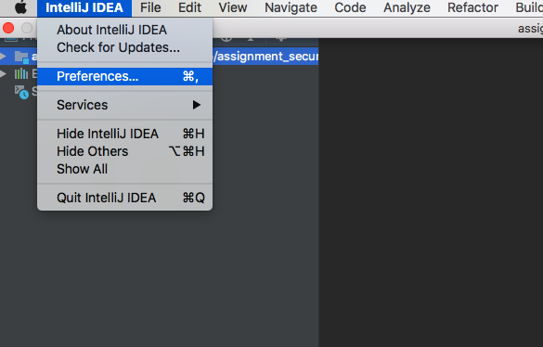
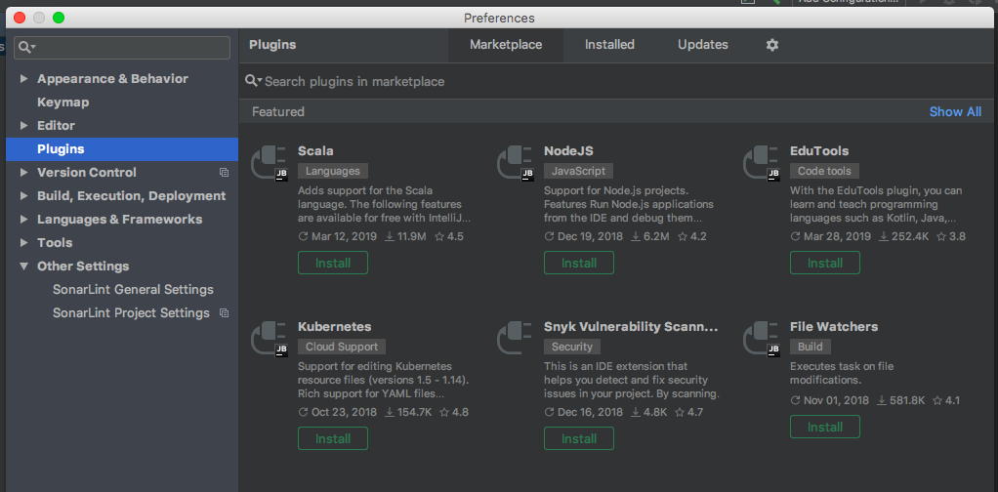
How to add SonarLint to your project?

Slide 17
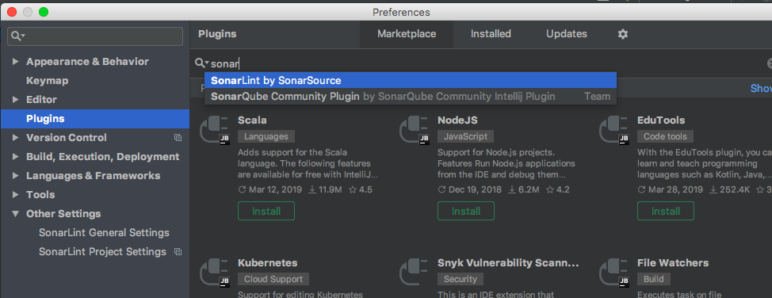
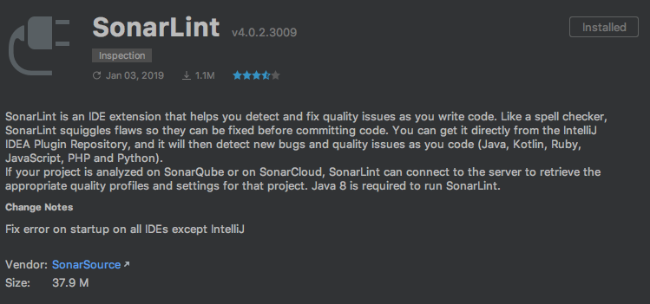
How to add SonarLint to your project?

Slide 18
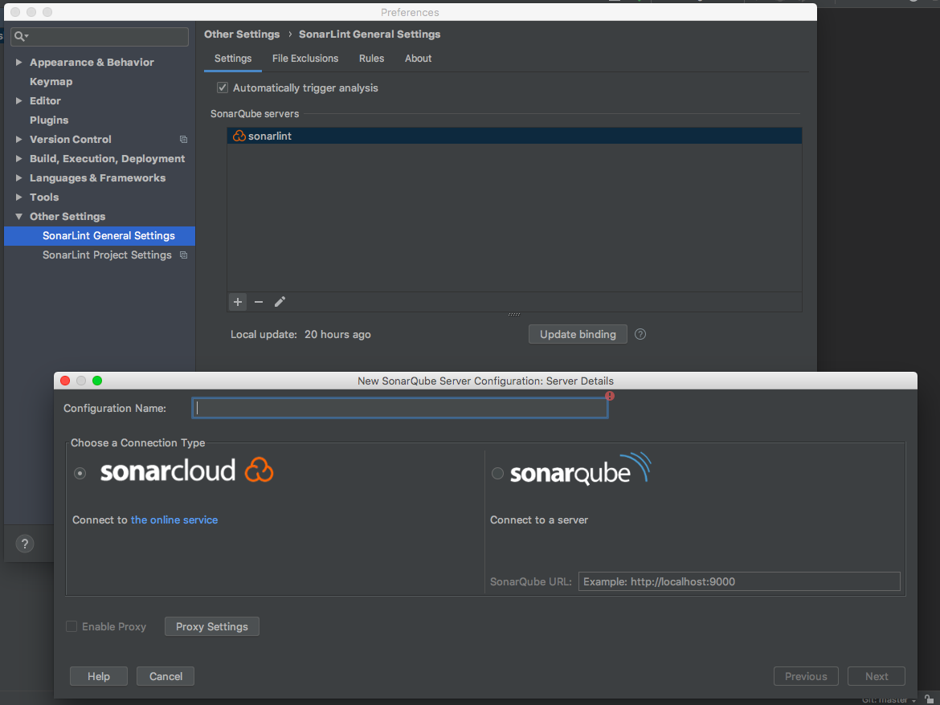
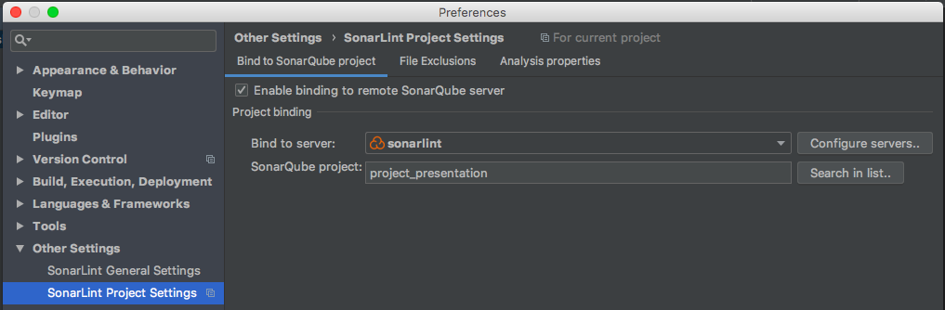
You can link your project to:
SonarQube (server)
SonarCloud (you need an account GitHub)
https://www.sonarlint.org/eclipse/
https://www.sonarlint.org/intellij/index.html

Slide 19
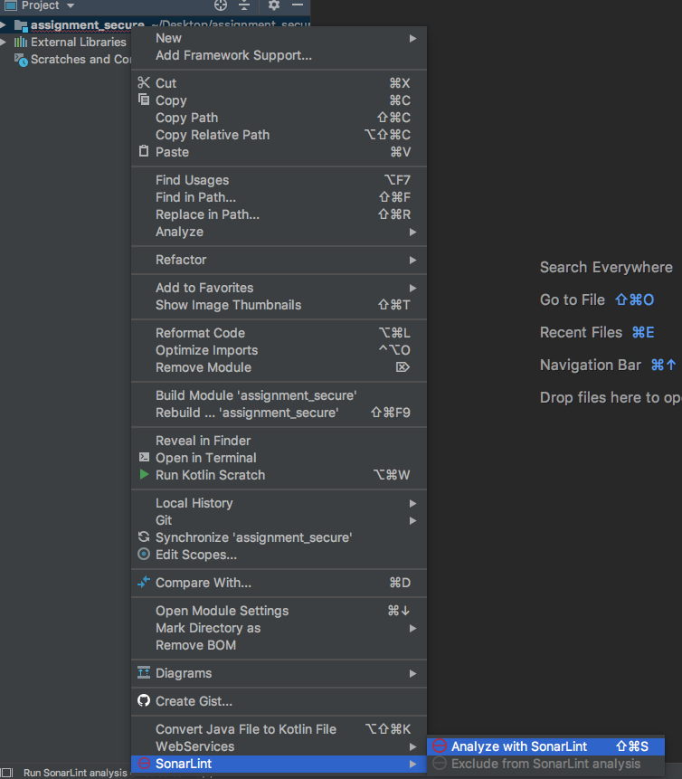
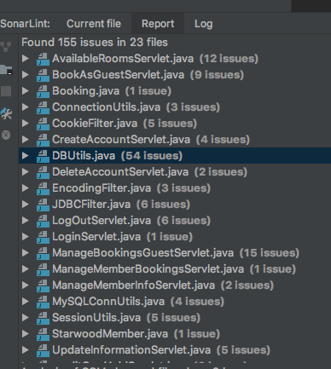
How to add SonarLint to your project?

Slide 20
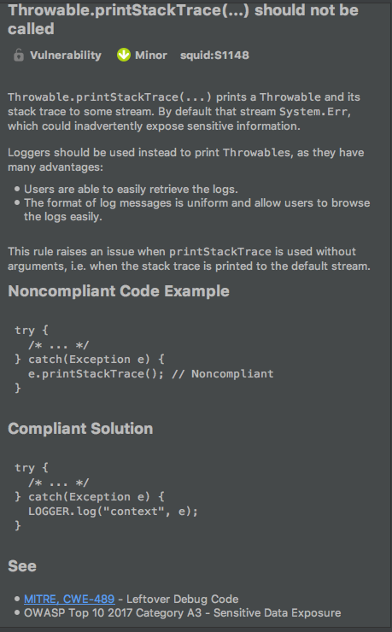
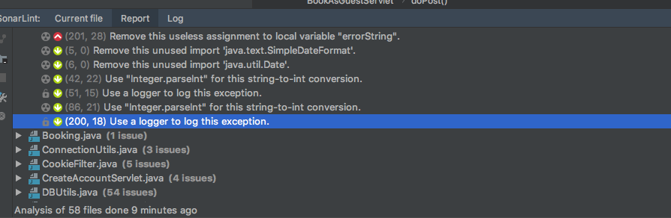
Different issues: type, information and critical score:
For each issue, SonarLint gives:
A type: vulnerability, code smells or bug
A critical score
Information: explanation, solution to fix it, external references

Slide 21
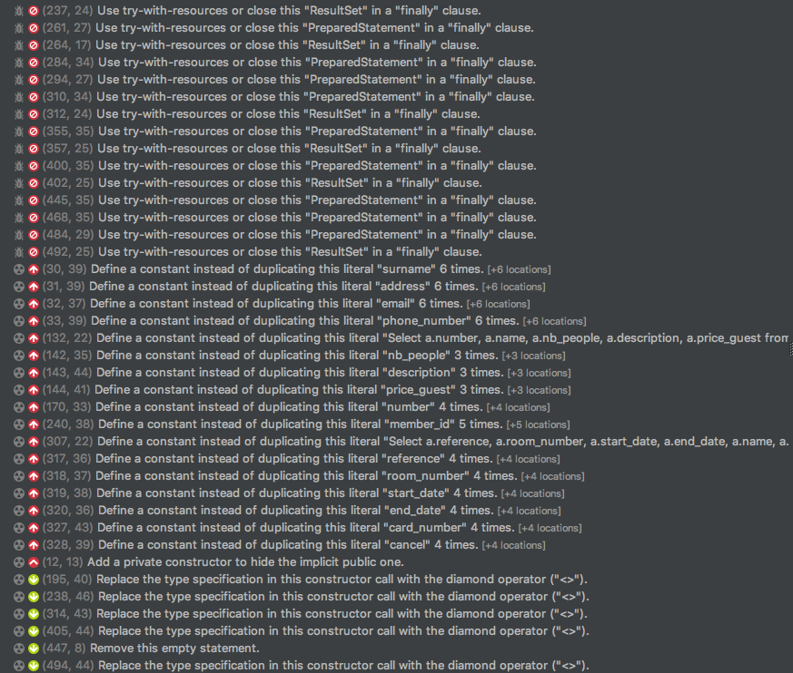
Limits to the report in the case of vulnerabilities:
All the vulnerabilities are not found.
Application vulnerable to SQL injections BUT not vulnerabilities in the report in the file DBUtils.
2. Presence of false positives
Raise vulnerabilities which are not really a vulnerability.
3. Rank of vulnerabilities
The rank assigned is not always good.
https://www.owasp.org/index.php/Static_Code_Analysis

Slide 22
Conclusion:
Static Analysis Tools
Analyse the source code
Not the same thing that dynamical analysis tools, because no execution of the code
SonarQube and its derivatives
Open-source static analysis tool
Help to develop reusable, maintainable and secure code
Different services: SonarQube, SonarCloud, and SonarLint
Limits
Problem to spot some vulnerabilities
Need other tools and procedures in complement to make secure software

